Slide 1

Image to Text Interactive System
for PDF Documents
Honors Project Phase 2 Review I
Ashutosh Rai
Roll.No: 2020BCS0020
Guided by: Dr. Selvi C
Department of Computer Science and Engineering
Indian Institute of Information Technology Kottayam
November 11, 2023
Image to Text Interactive System for PDF Documents Ashutosh Rai – 2020BCS0020 Ashutosh Rai – 2020BCS0020

Slide 2
Introduction
Managing and extracting valuable information from a multitude of document images is a complex and time consuming process.
The proposed system aims to tackle this challenge by leveraging a combination of cutting edge technologies including OCR, VDU, RAG.
Traditional LLM applications, while useful for document Q/A, they don’t function with image inputs, and are susceptible to hallucinations.
This project aims to bridge the modality gap and address the hallucination issues.
Image to Text Interactive System for PDF Documents Ashutosh Rai – 2020BCS0020 Ashutosh Rai – 2020BCS0020

Slide 3
Recap
Worked on implementing the Layout parser in conjunction with the tesseract OCR, followed by a detailed performance analysis based on CER and WER.
Fine tuned the DONUT model on an invoice dataset, which involved additional preprocessing and provided a performance analysis for the DONUT model.
Image to Text Interactive System for PDF Documents Ashutosh Rai – 2020BCS0020 Ashutosh Rai – 2020BCS0020

Slide 4
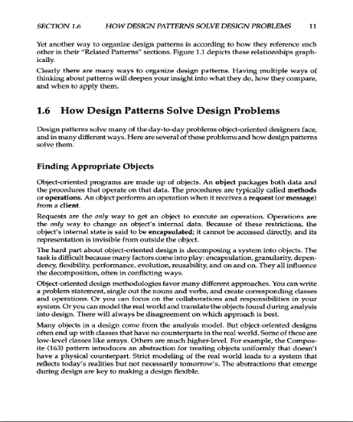
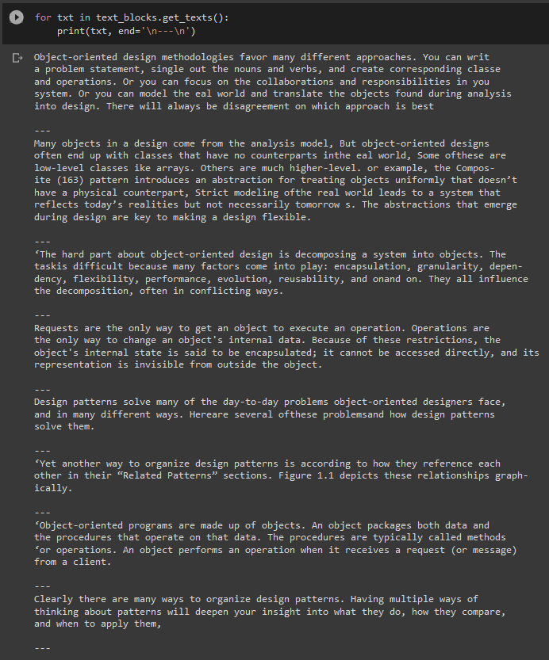
Previous Experimental Results
Layout Parser:
Sample Input and output:
Image to Text Interactive System for PDF Documents Ashutosh Rai – 2020BCS0020 Ashutosh Rai – 2020BCS0020

Slide 5
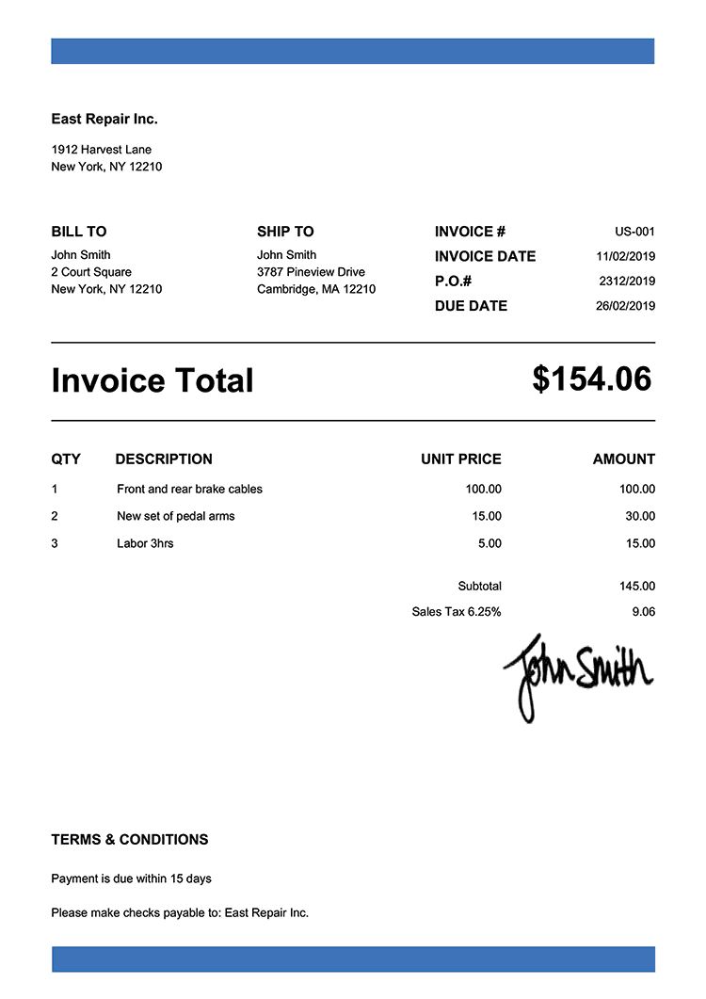
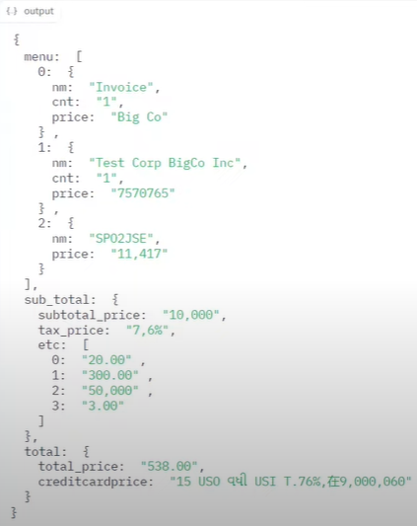
Previous Experimental Results
DONUT:
Sample Invoice input and output:
Image to Text Interactive System for PDF Documents Ashutosh Rai – 2020BCS0020 Ashutosh Rai – 2020BCS0020

Slide 6
Problem Statement
The problem at hand is the lack of an effective and user-friendly AI-based image-to-text Q/A system that can perform template-free information retrieval from images. Currently available solutions require large datasets for training and have limited user-friendly interfaces, making it difficult for end-users to efficiently extract information from images. The proposed system should overcome these limitations by providing a user-friendly Q/A interface and the ability to perform information extraction from images without the need for extensive training datasets or complicated interfaces.
Image to Text Interactive System for PDF Documents Ashutosh Rai – 2020BCS0020 Ashutosh Rai – 2020BCS0020

Slide 7
Methodology
Traditional approaches for document Q/A rely solely on LLMs for generating answers.
While LLMs are capable, they present limitations when dealing with document based questions such as limited contextual understanding, computational inefficiencies.
The RAG based approach addresses these limitations. It involves two main steps, retrieval and generation
The retrieval step selects the relevant passages/documents based on user query ensuring access to document context.
Image to Text Interactive System for PDF Documents Ashutosh Rai – 2020BCS0020 Ashutosh Rai – 2020BCS0020

Slide 8
Methodology
An LLM then processes the retrieved context and builds on it to generate the answer, making up the generation step.
This makes the process more efficient and precise.
Image to Text Interactive System for PDF Documents Ashutosh Rai – 2020BCS0020 Ashutosh Rai – 2020BCS0020

Slide 9
Workflow
Data Loading: We begin by utilizing a data loader to access and convert documents from various formats into a standardized format, ensuring data accessibility.
Document Splitting: Implement document splitting to break down documents into smaller, semantically relevant chunks. Carefully split documents based on defined chunk size and chunk overlap to avoid information gaps.
Embeddings and VectorDB: Generate vector embeddings for the text chunks, and store these embeddings in a vector store for efficient retrieval.
Image to Text Interactive System for PDF Documents Ashutosh Rai – 2020BCS0020 Ashutosh Rai – 2020BCS0020

Slide 10
Workflow
RAG pipeline:
Initiate the pipeline with the document
Segment the text into chunks for the loaded document
Convert and store these chunks as embeddings in a vector store
Compare query and document embeddings within the vector store to identify the most similar passages/document chunks.
Retrieve the most similar chunks from the vector store.
Feed these chunks and the query into a LLM to generate the answer.
Image to Text Interactive System for PDF Documents Ashutosh Rai – 2020BCS0020 Ashutosh Rai – 2020BCS0020

Slide 11
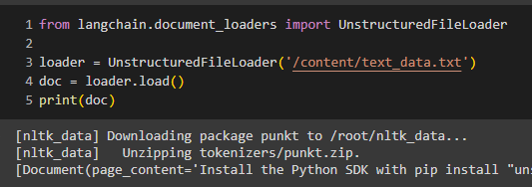
Notebook Demonstration
The pipeline leverages Langchain, a language model integration framework, to conduct the RAG based Q/A.
Initiate by loading in the text file using langchain’s document loader, UnstructuredFileLoader.
Following loading, set the configurations and download the LLM model (Flan-ulv2) from HuggingFacehub.
Image to Text Interactive System for PDF Documents Ashutosh Rai – 2020BCS0020 Ashutosh Rai – 2020BCS0020

Slide 12
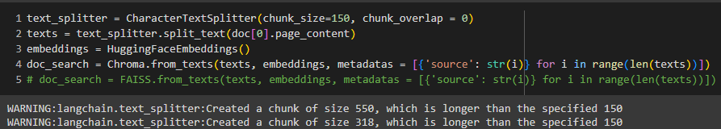
Notebook Demonstration
Langchain’s CharactertextSplitter performs text chunking for the document.
The chunks are passed through the HuggingFaceEmbeddings to convert them into vector embeddings and then stored in the vector store Chroma, serving as a document search object.
Image to Text Interactive System for PDF Documents Ashutosh Rai – 2020BCS0020 Ashutosh Rai – 2020BCS0020

Slide 13
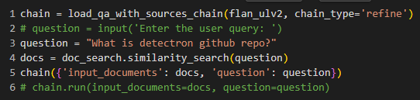
Notebook Demonstration
Now establish a question answering chain, and pass it the previously loaded LLM model. The retrieval step is initiated by passing the query to the document search object.
The user query along with the retrieved documents from the previous step, as context are used to run the chain, which generates the answer.
Image to Text Interactive System for PDF Documents Ashutosh Rai – 2020BCS0020 Ashutosh Rai – 2020BCS0020

Slide 14
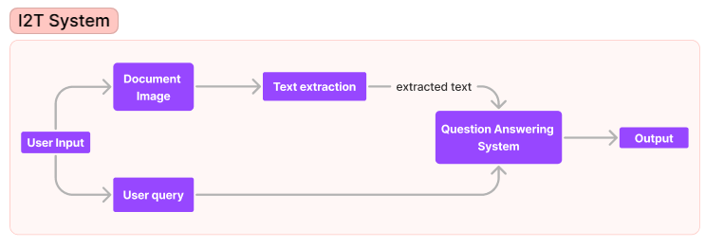
Workflow Diagram
Image to Text Interactive System for PDF Documents Ashutosh Rai – 2020BCS0020 Ashutosh Rai – 2020BCS0020

Slide 15
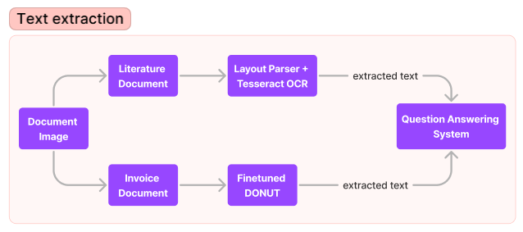
Workflow Diagram
Image to Text Interactive System for PDF Documents Ashutosh Rai – 2020BCS0020 Ashutosh Rai – 2020BCS0020

Slide 16
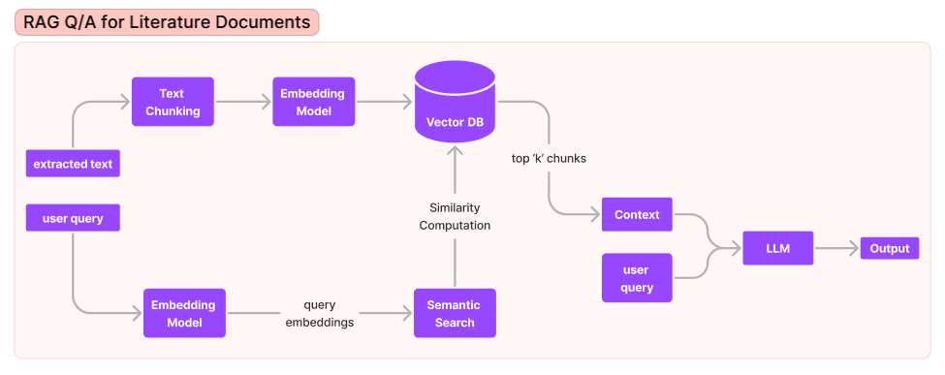
Workflow Diagram
Image to Text Interactive System for PDF Documents Ashutosh Rai – 2020BCS0020 Ashutosh Rai – 2020BCS0020

Slide 17
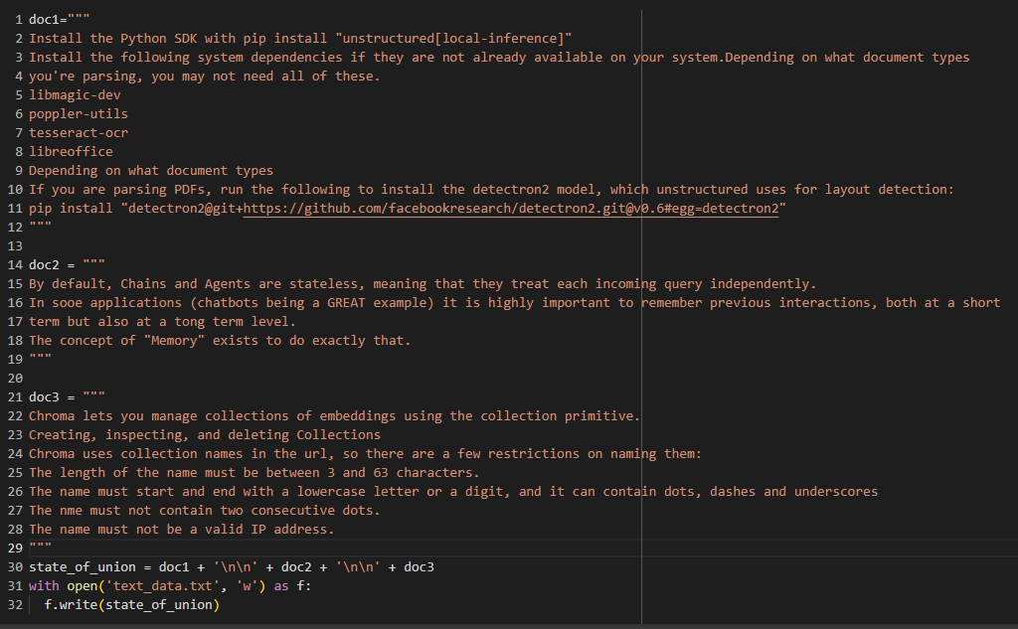
Experimental Results
RAG Pipeline:
Sample Input Document:
Image to Text Interactive System for PDF Documents Ashutosh Rai – 2020BCS0020 Ashutosh Rai – 2020BCS0020

Slide 18
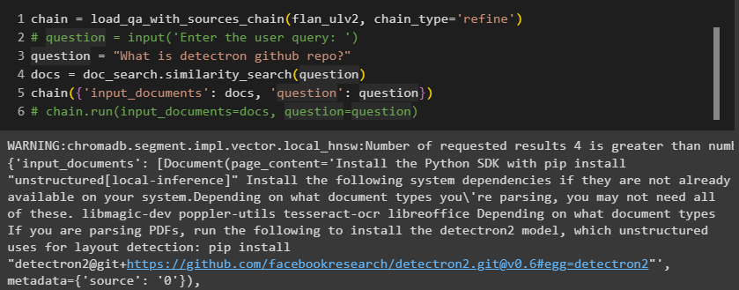
Experimental Results
RAG Pipeline:
Output for user query:
Image to Text Interactive System for PDF Documents Ashutosh Rai – 2020BCS0020 Ashutosh Rai – 2020BCS0020

Slide 19
Performance Analysis
The following benchmarking was performed on the MMLU (Massive Multitask Language Understanding) Dataset.
Insights gained from the Performance analysis:
Extra context typically improves performance
Smaller models benefit from additional knowledge.
The LLM’s employed for the benchmarking are: gpt-3.5-turbo and llama2-13b-chat.
The test compared the performance without and with context, showing how a LLM can learn from knowledge.
Image to Text Interactive System for PDF Documents Ashutosh Rai – 2020BCS0020 Ashutosh Rai – 2020BCS0020

Slide 20
Performance Analysis
Both llama2 and gpt-3.5 are enhanced by around 3-5% even with the ‘Top-1’ context.
RAG is a more practical approach than fine tuning models, serving as a plug-in solution compatible with both self-hosted and remote models.
Image to Text Interactive System for PDF Documents Ashutosh Rai – 2020BCS0020 Ashutosh Rai – 2020BCS0020

Slide 21
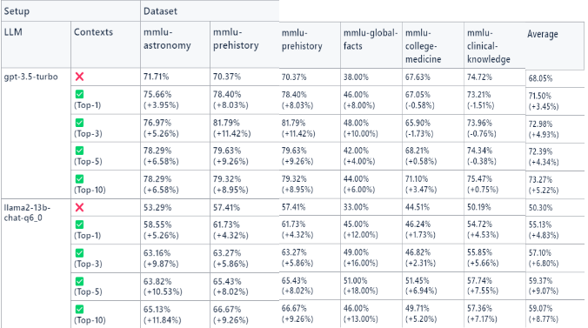
Performance Analysis
Image to Text Interactive System for PDF Documents Ashutosh Rai – 2020BCS0020 Ashutosh Rai – 2020BCS0020

Slide 22
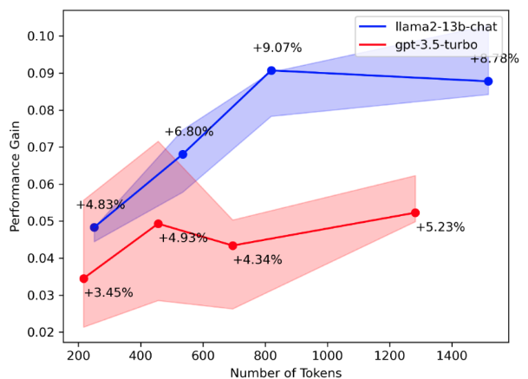
Performance Analysis
Fig: Performance Gain vs No. of Context
Image to Text Interactive System for PDF Documents Ashutosh Rai – 2020BCS0020 Ashutosh Rai – 2020BCS0020

Slide 23
Conclusion
In conclusion, the performance analysis reveals that the incorporation of extra context enhances the LLM performance, with the smaller LLM models benefiting notably. Additionally it offers a plug-in approach in contrast to the end to end fine tuning.
Image to Text Interactive System for PDF Documents Ashutosh Rai – 2020BCS0020 Ashutosh Rai – 2020BCS0020

Slide 24
References
Shen, Z., Zhang, R., Dell, M., Lee, B. C. G., Carlson, J., & Li, W. (2021). LayoutParser: A unified toolkit for deep learning based document image analysis. In Document Analysis and Recognition–ICDAR 2021: 16th International Conference, Lausanne, Switzerland, September 5–10, 2021, Proceedings, Part I 16 (pp. 131-146). Springer International Publishing.
Kim, G., Hong, T., Yim, M., Nam, J., Park, J., Yim, J., ... & Park, S. (2022, October). Ocr-free document understanding transformer. In Computer Vision–ECCV 2022: 17th European Conference, Tel Aviv, Israel, October 23–27, 2022, Proceedings, Part XXVIII (pp. 498-517). Cham: Springer Nature Switzerland.
Image to Text Interactive System for PDF Documents Ashutosh Rai – 2020BCS0020 Ashutosh Rai – 2020BCS0020

Slide 25
References
3. https://thenewstack.io/discover-the-performance-gain-with-retrieval-augmented-generation/
4. https://medium.aiplanet.com/advanced-rag-implementation-on-custom-data-using-hybrid-search-embed-caching-and-mistral-ai-ce78fdae4ef6
5. https://deci.ai/blog/fine-tuning-peft-prompt-engineering-and-rag-which-one-is-right-for-you/
Image to Text Interactive System for PDF Documents Ashutosh Rai – 2020BCS0020 Ashutosh Rai – 2020BCS0020

Slide 26
Thank you
Image to Text Interactive System for PDF Documents Ashutosh Rai – 2020BCS0020 Ashutosh Rai – 2020BCS0020

